Slide 1

Walmart Sales Project

Slide 2
Agenda 1- define objective 2- Apply data exploration method 3- Apply data cleaning(preprocessing ) 4- visualization for the data 5- Develop and evaluate machine model 6- Time Series for sales of walmart

Slide 3
Introduction
we will delve into a comprehensive analysis of Walmart's sales dataset, Through rigorous examination and advanced analytics, we aim to provide actionable insights to Walmart's stakeholders, enabling informed decision-making and strategic planning

Slide 4
Objective
The objective of this project is to analyze the Walmart sales dataset and provide actionable insights to the owners to optimize business strategies.
Determine which product categories generate the highest sales revenue, allowing Walmart to focus resources and marketing efforts on high-performing categories.
Understanding customer segments' preferences and behaviors enables targeted marketing and personalized strategies to maximize sales.
Explore how various factors such as product category, customer segment, region, and discounts influence each other and impact sales and profitability. Understanding these relationships enables Walmart to make informed decisions and optimize business operations.

Slide 5
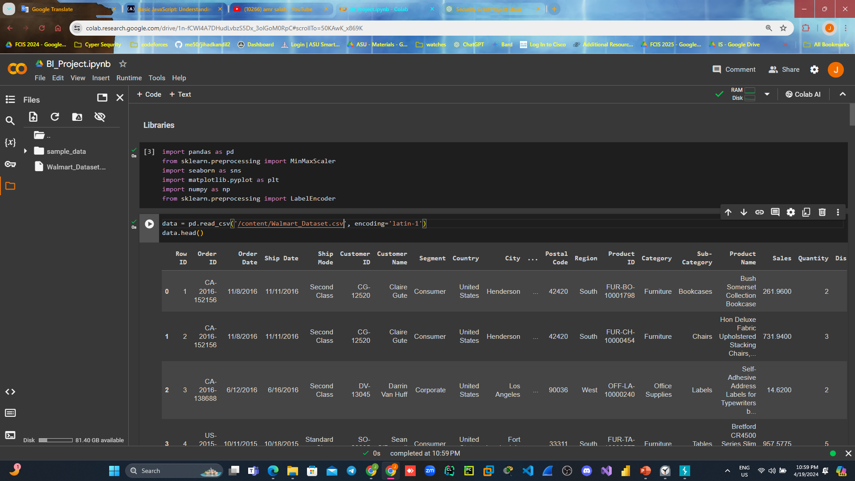
First : loading data

Slide 6
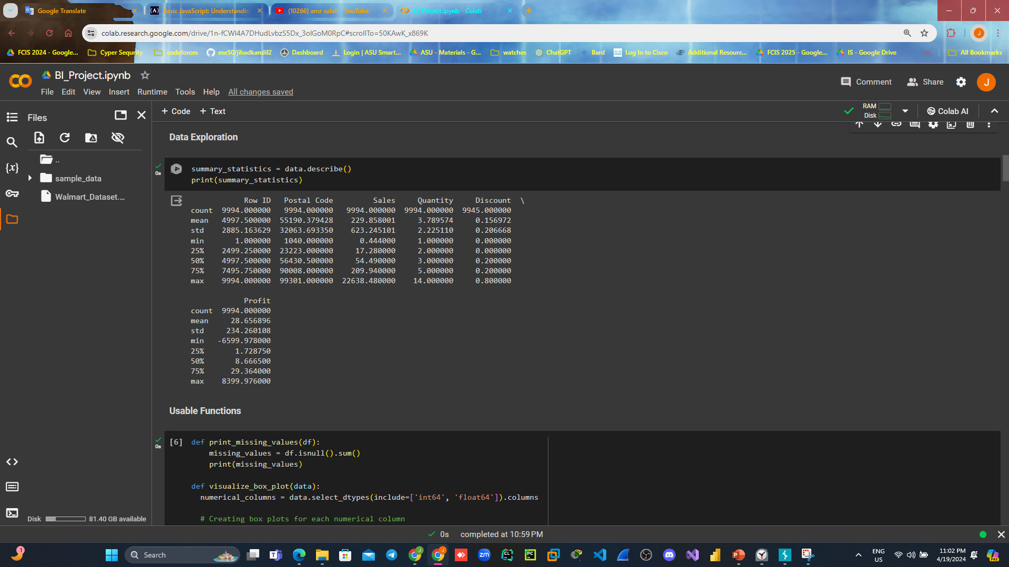
Second :Data Exploration

Slide 7
Data preprocessing
Steps:
[1] drop unnecessary column
[2] Handle missing values (Null)
[3] Handle duplicate
[4] outlier handling
[5] Normalization
[6] Handling inconsistency

Slide 8
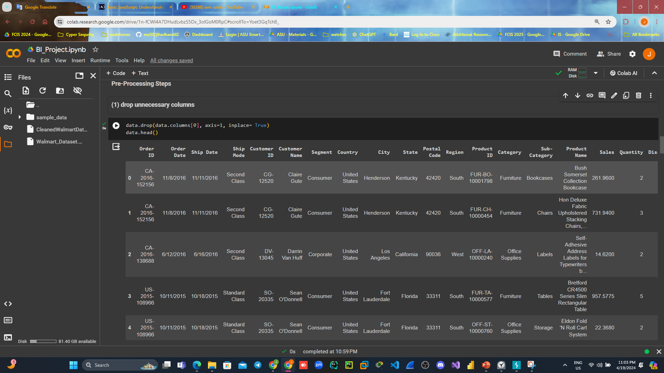
[1] drop unnecessary column:
Code: output:

Slide 9
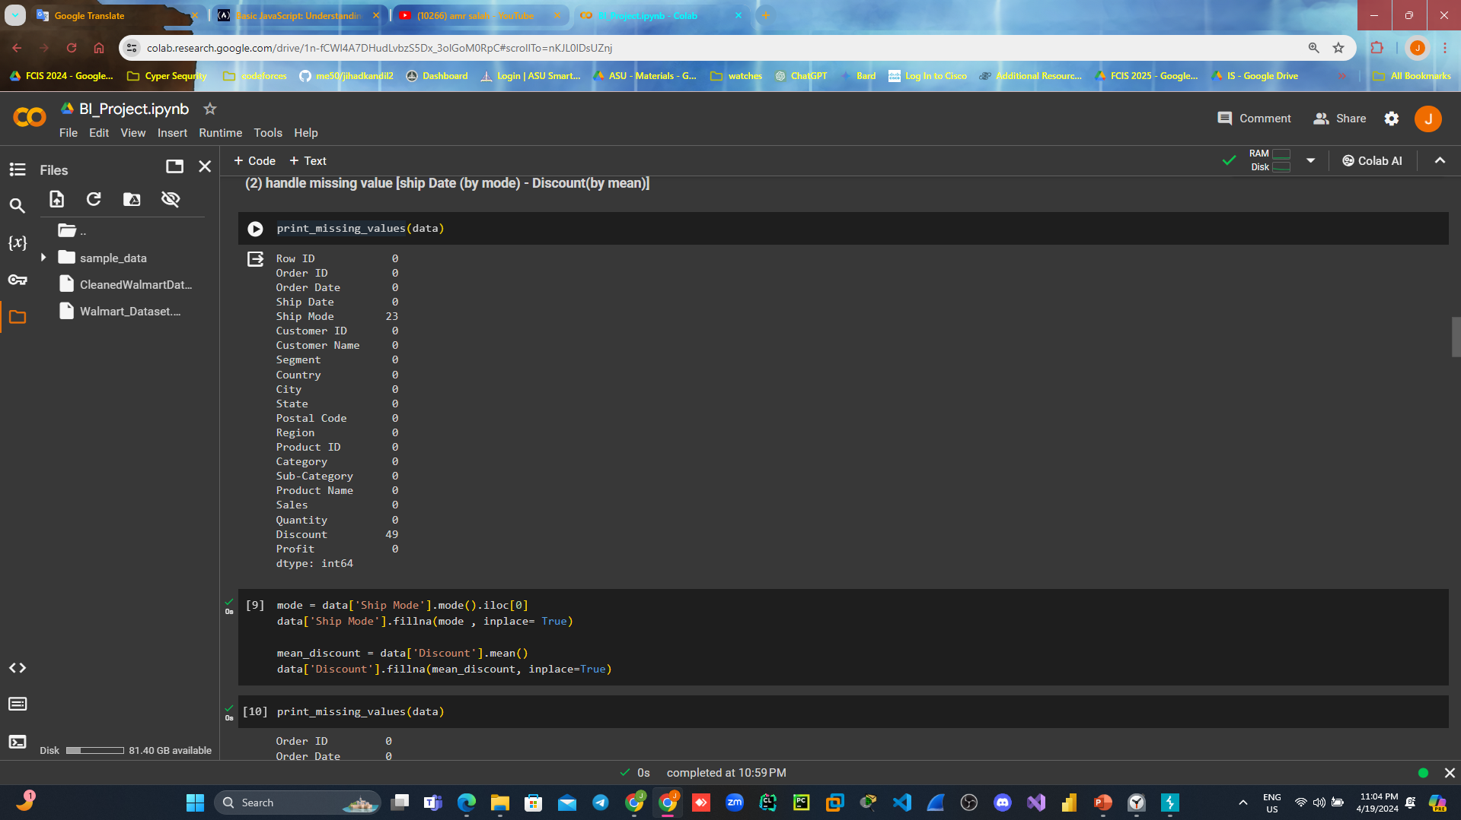
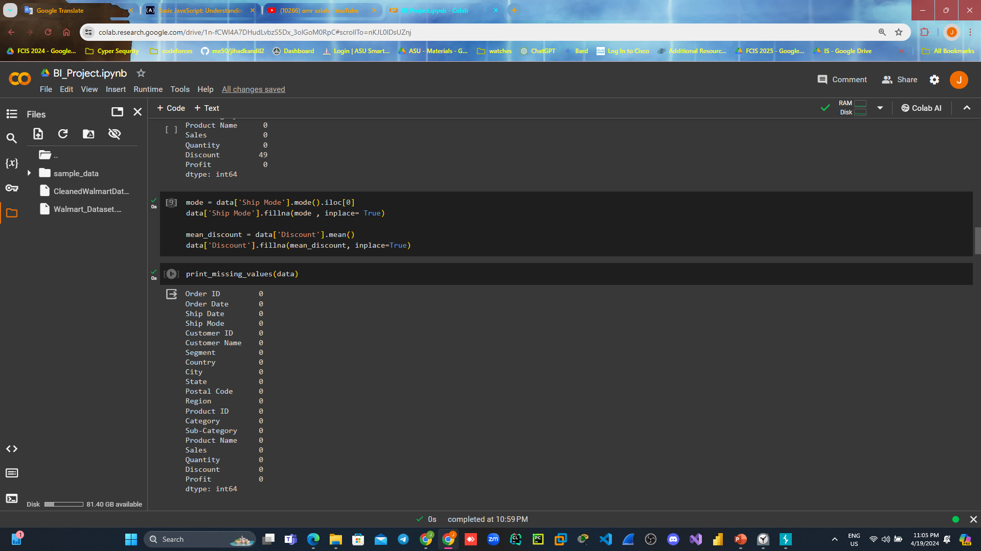
[2] Handle missing values (Null):
Code: before handling output After handling output:

Slide 10
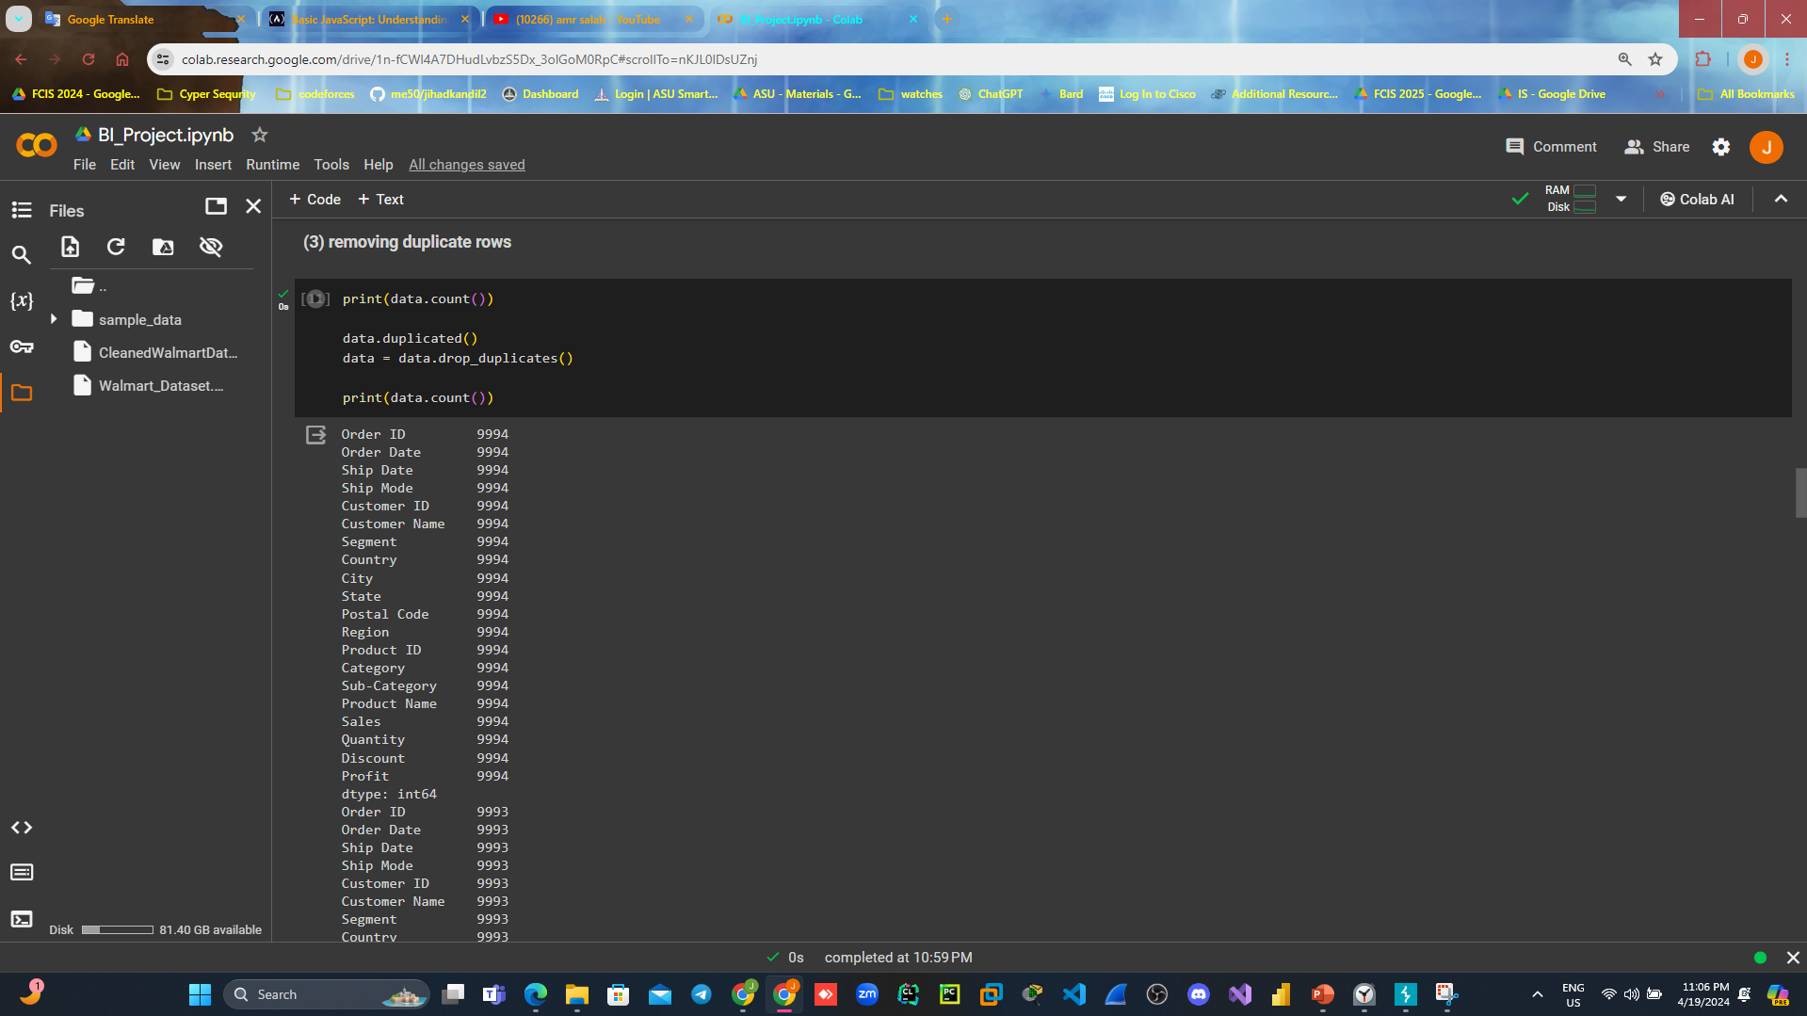
[3] Handle duplicates:
Code: in this case we found it by checking for the count of rows it decreased :

Slide 11
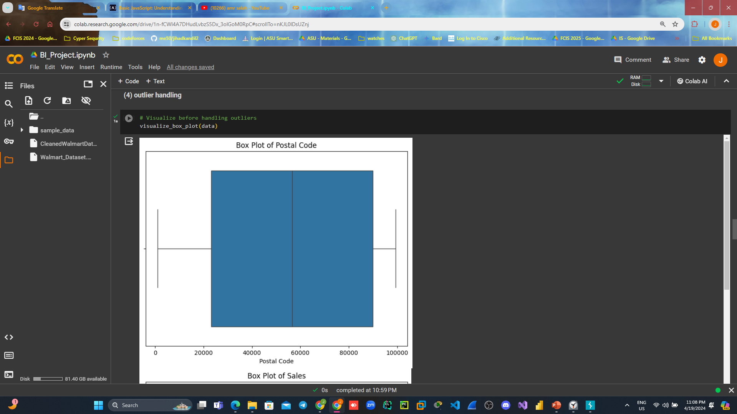
[4] outlier handling :
Code: by visualizing box plot of each column to see the outlier

Slide 12
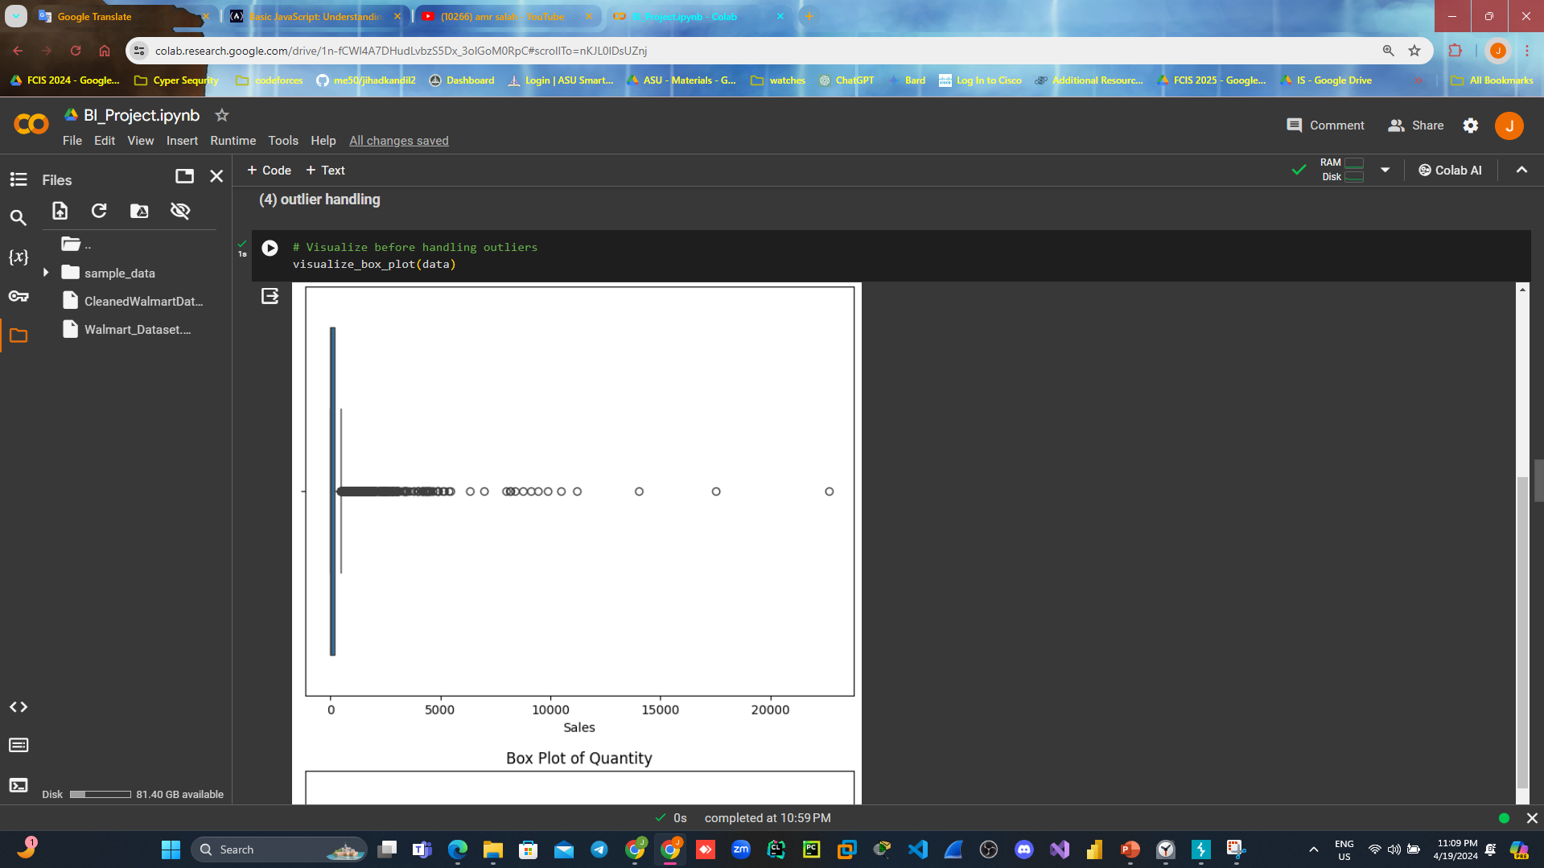
[4] outlier handling continue…..
Box plot of sales

Slide 13
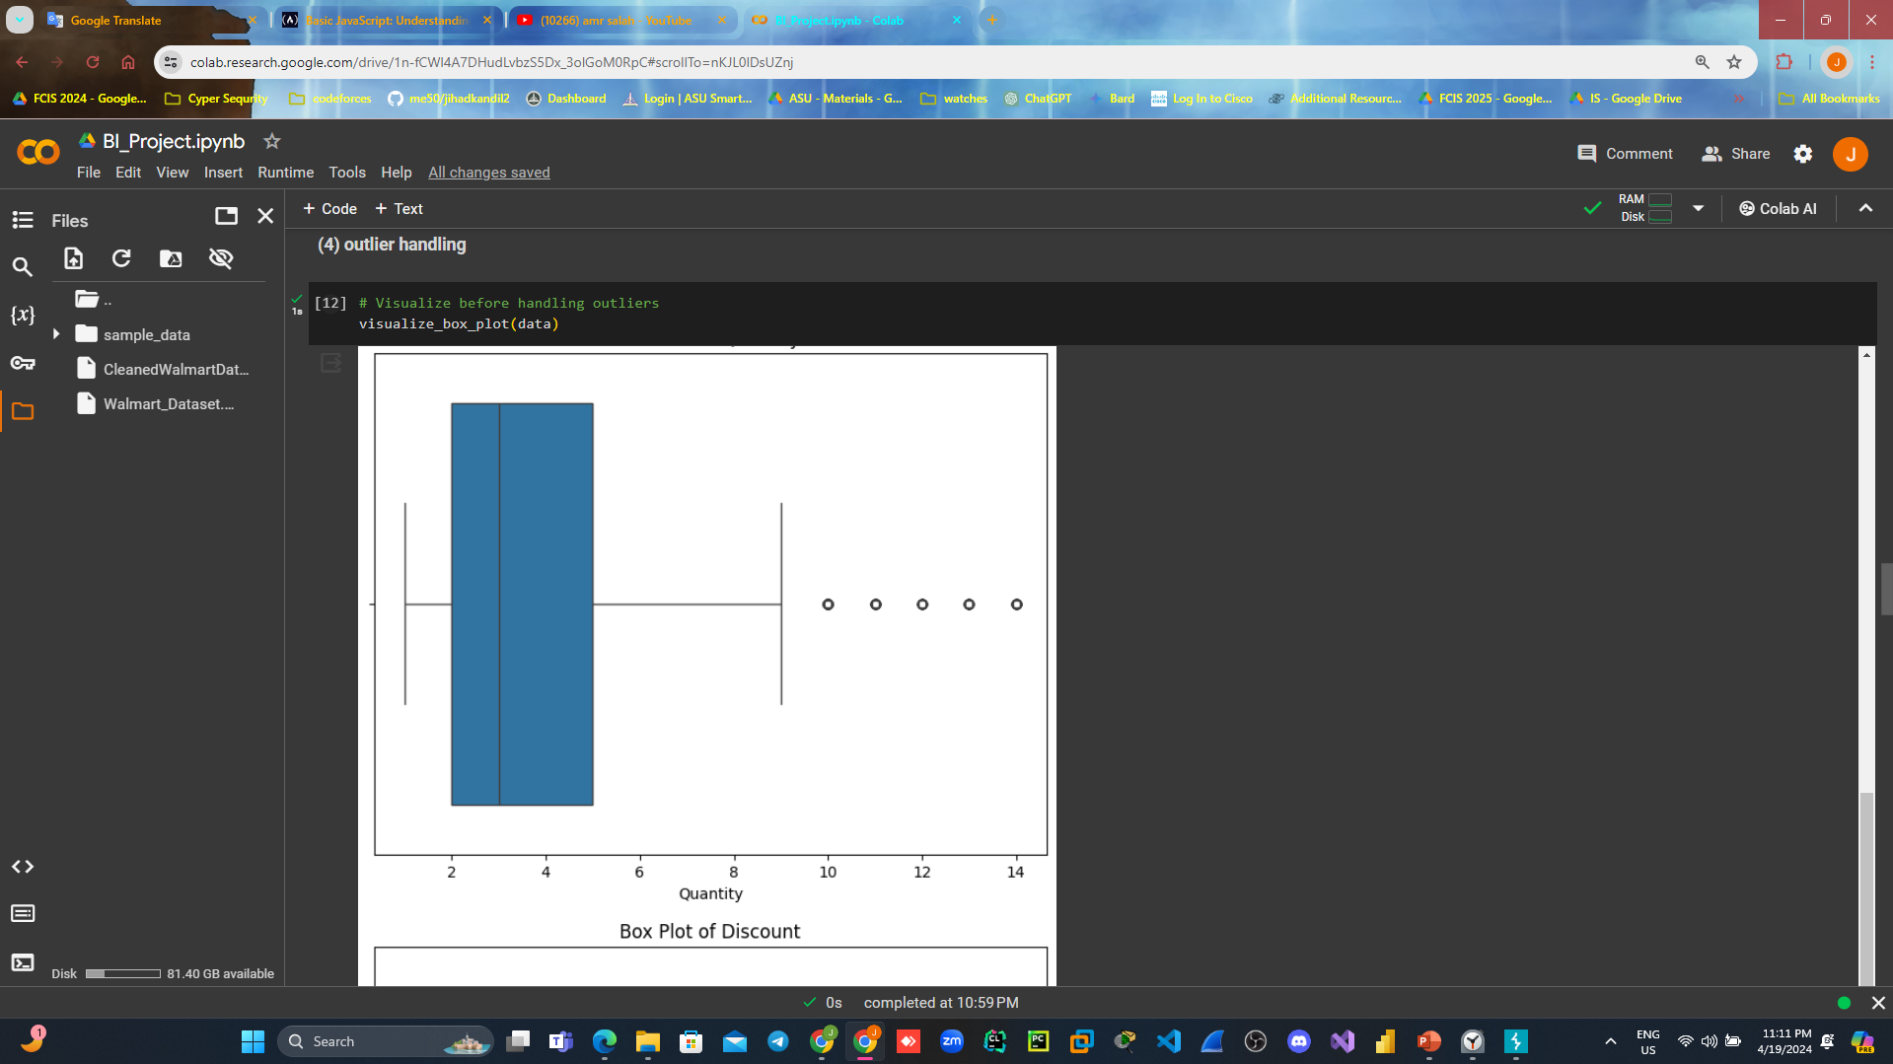
[4] outlier handling continue…..
Box plot of Quantity

Slide 14
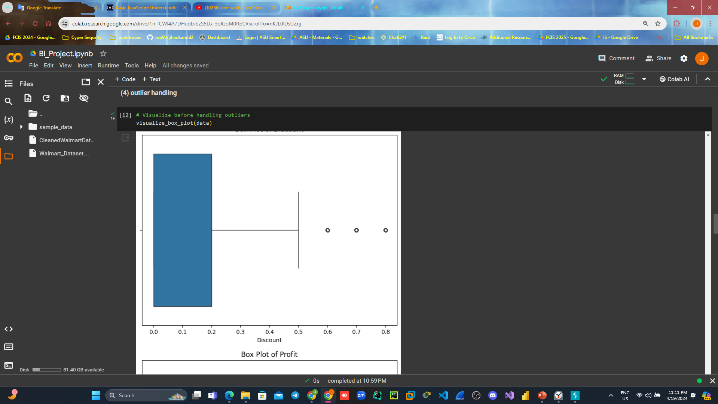
[4] outlier handling continue…..
Box plot of Discount

Slide 15
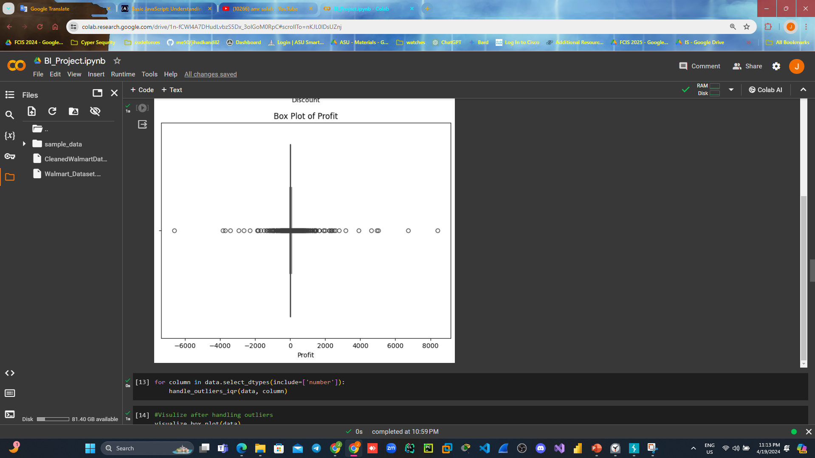
[4] outlier handling continue…..
Box plot of Profit

Slide 16
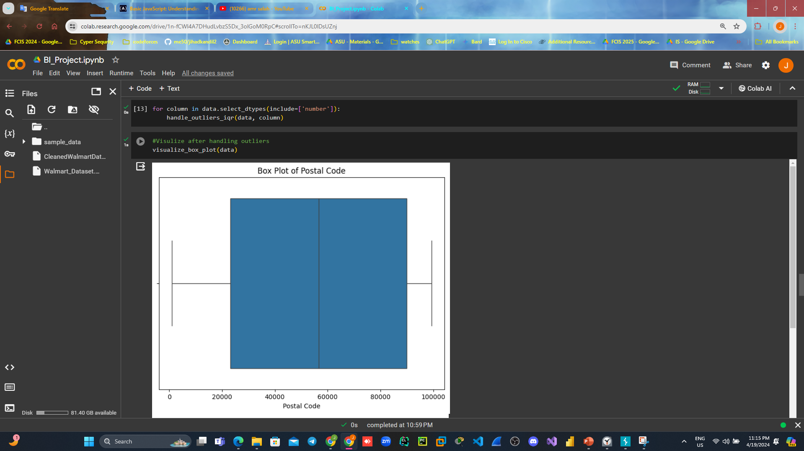
[4] outlier handling continue…..
After code of handling : Box plot of postal code:

Slide 17
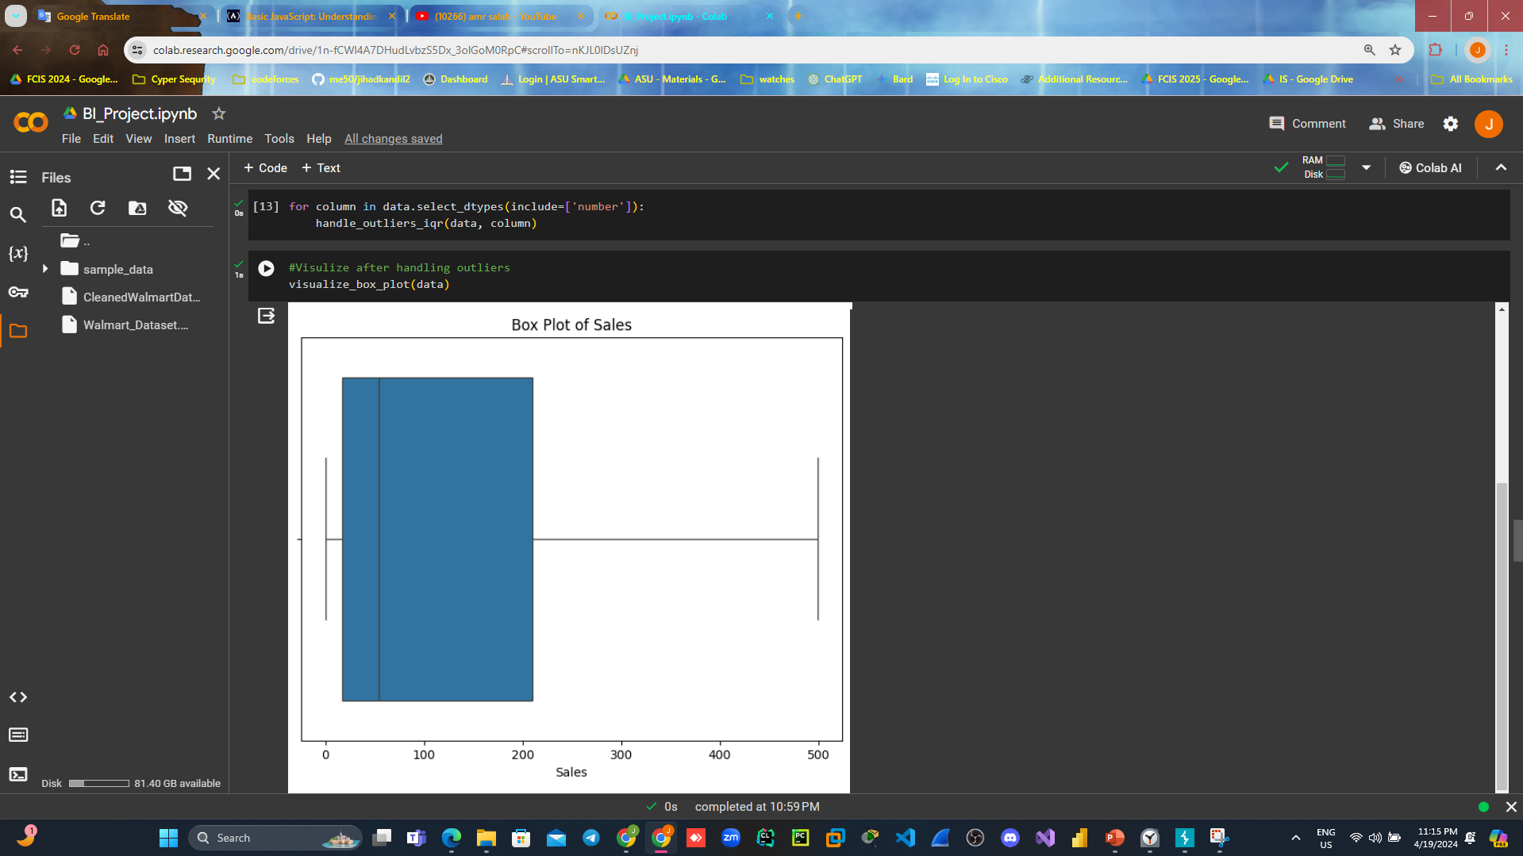
[4] outlier handling continue…..
Box plot of Sales:

Slide 18
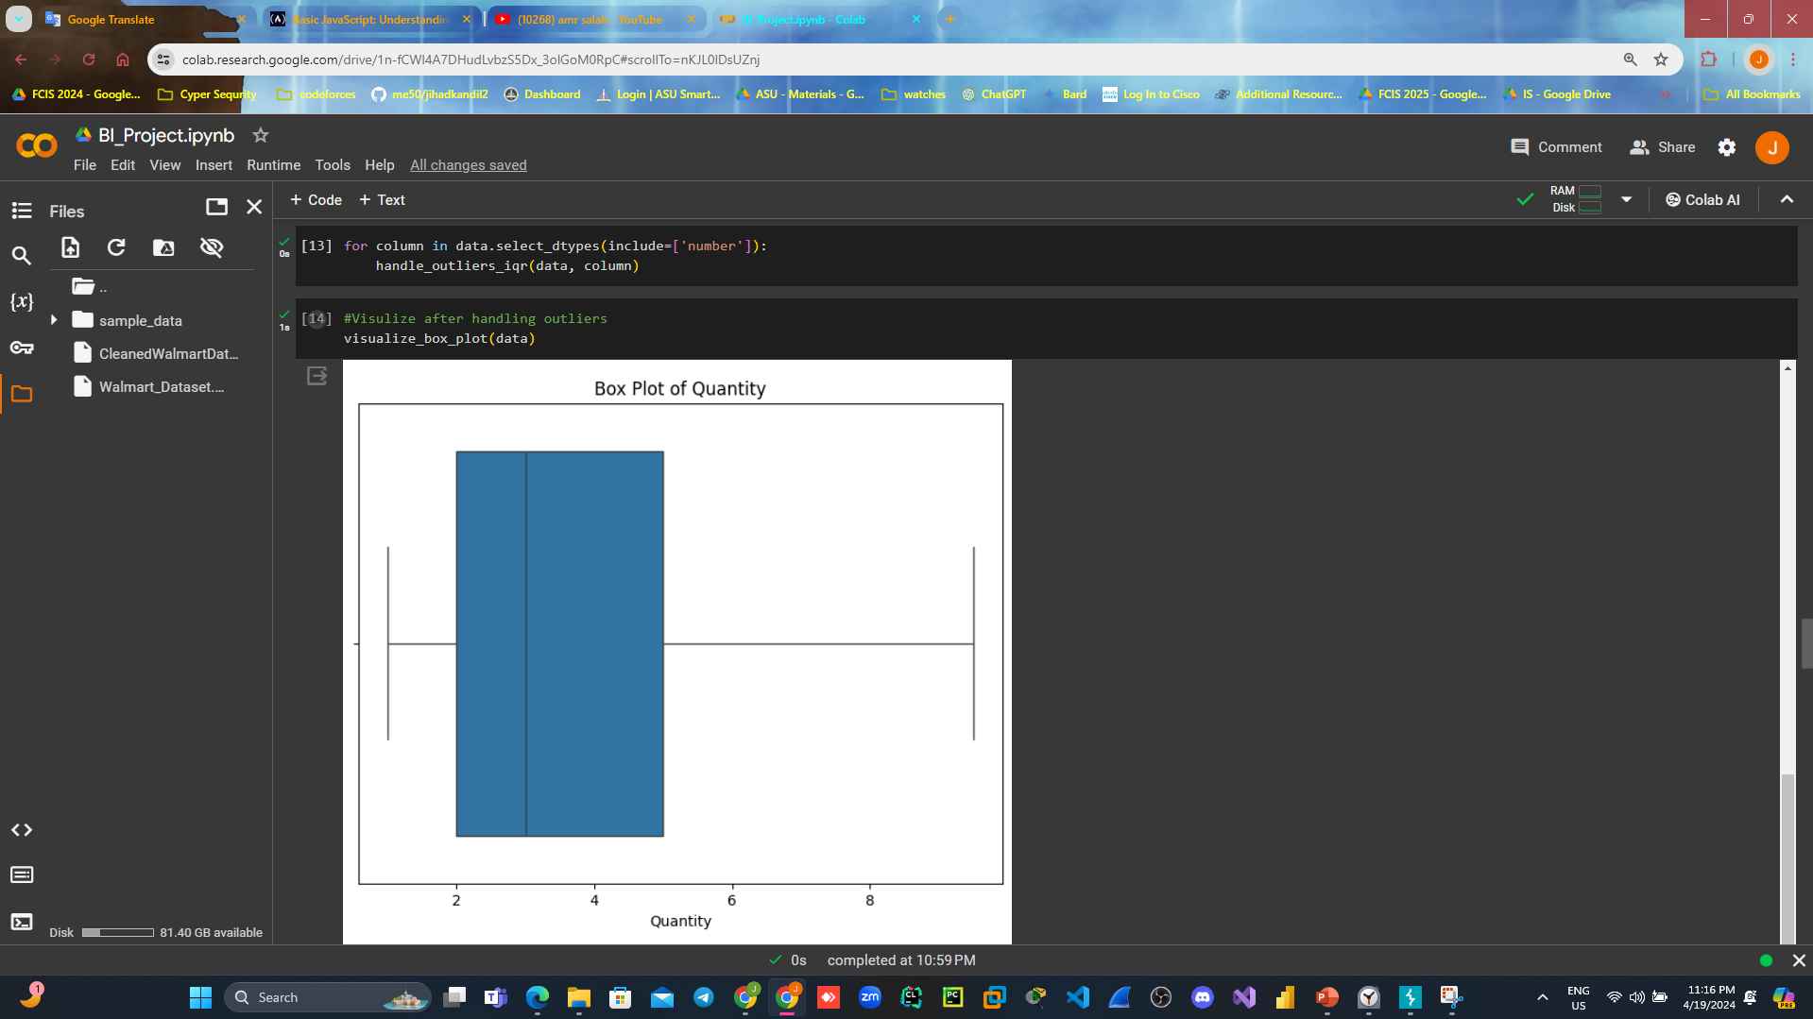
[4] outlier handling continue…..
Box plot of Quantity:

Slide 19

[4] outlier handling continue…..
Box plot of Discount:

Slide 20
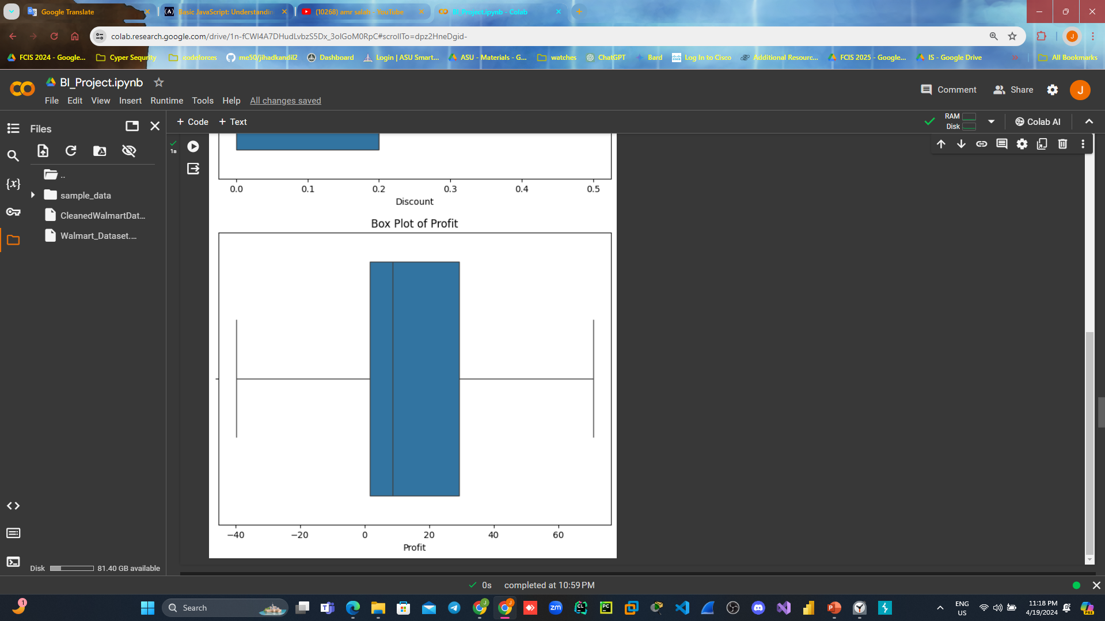
[4] outlier handling continue…..
Box plot of Profit

Slide 21
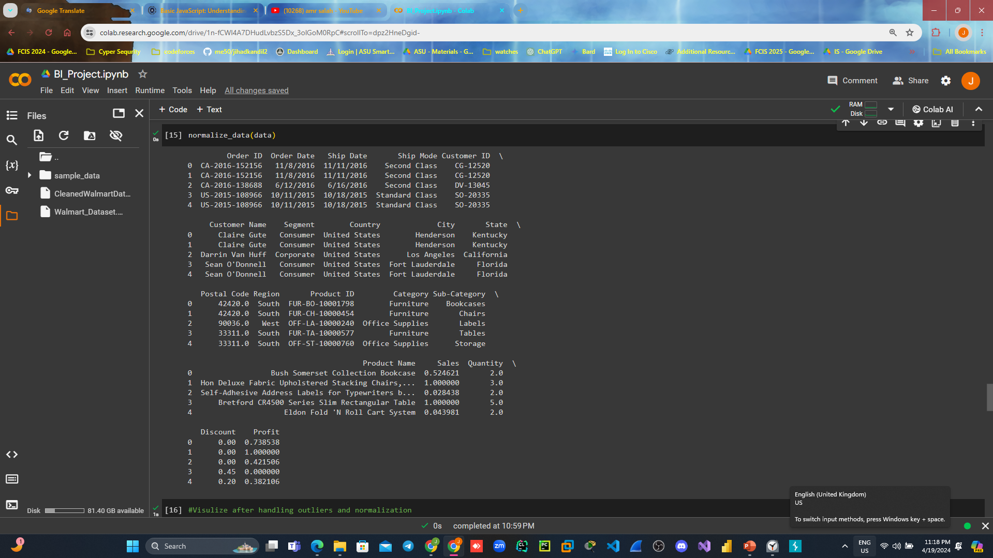
[5] Normalization:
Code:
we normalize data to handle negative value of the data so as we view box plot of the profit column to make sure :

Slide 22
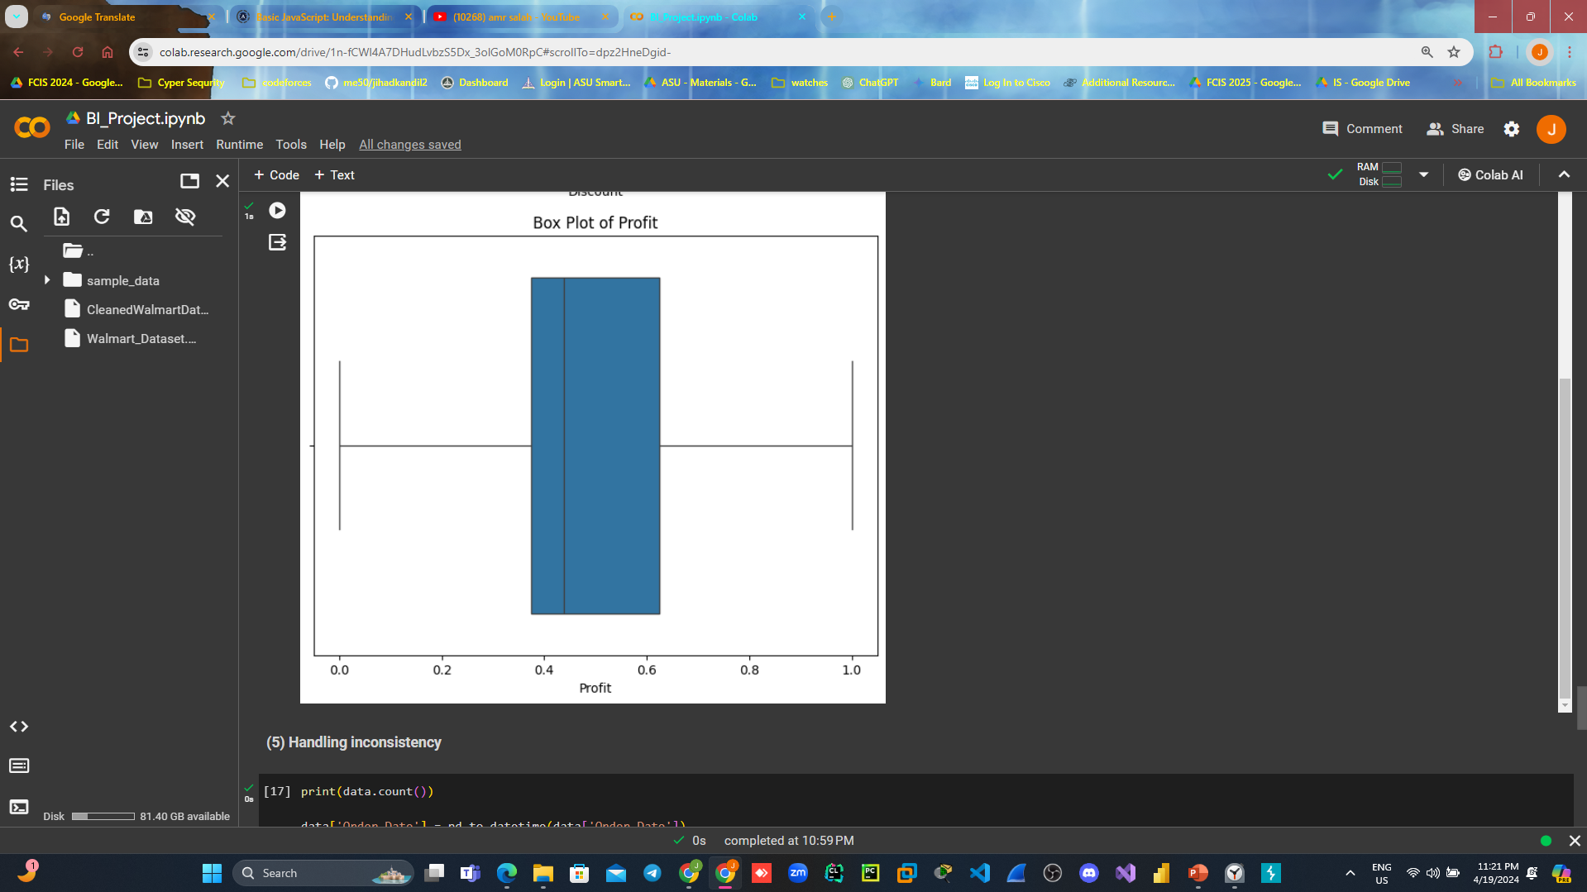
[5] Normalization continue……:
so as we view box plot of the profit column to make sure :

Slide 23
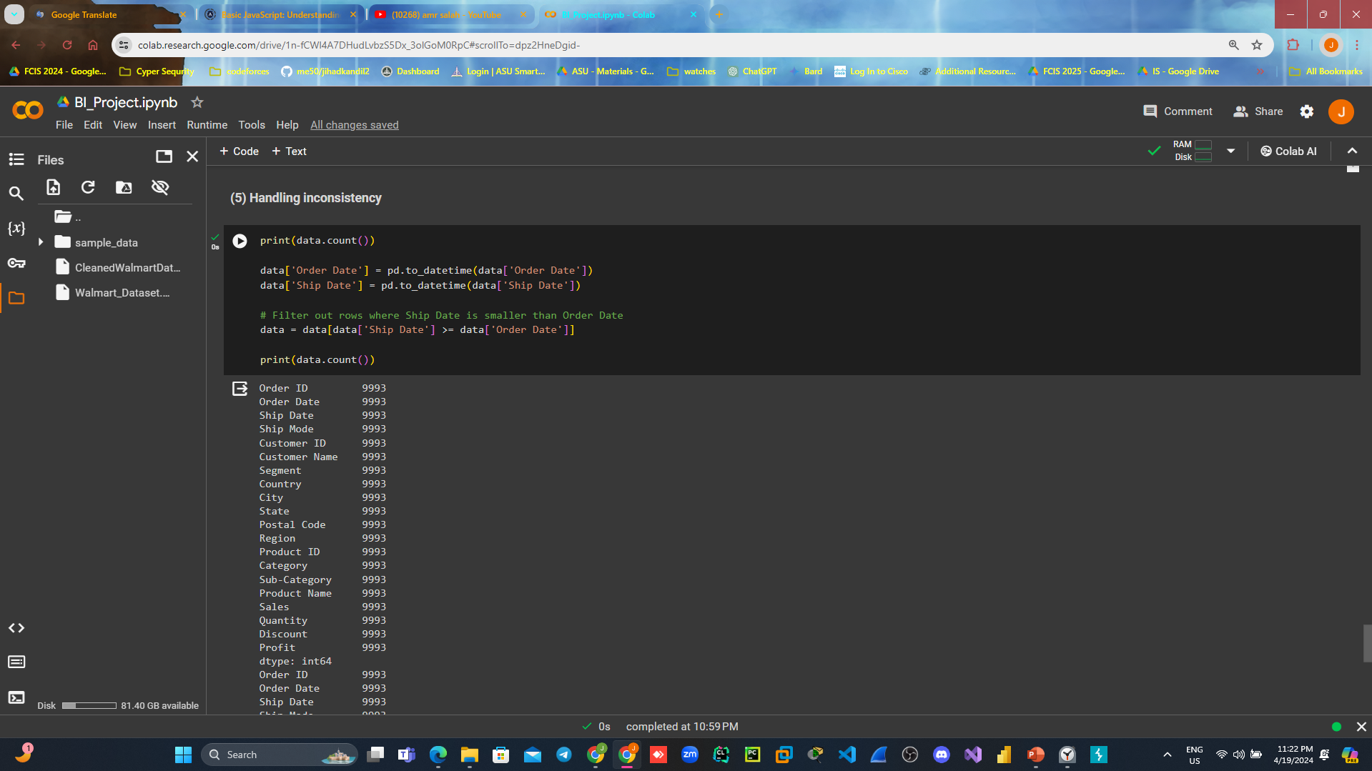
[6] Handling inconsistency:
For the logic of our data
the consistency could found if
The shipping date is before order date
If this found in the data we should drop:
So we check by count we find no conflict
Consistencies.

Slide 24
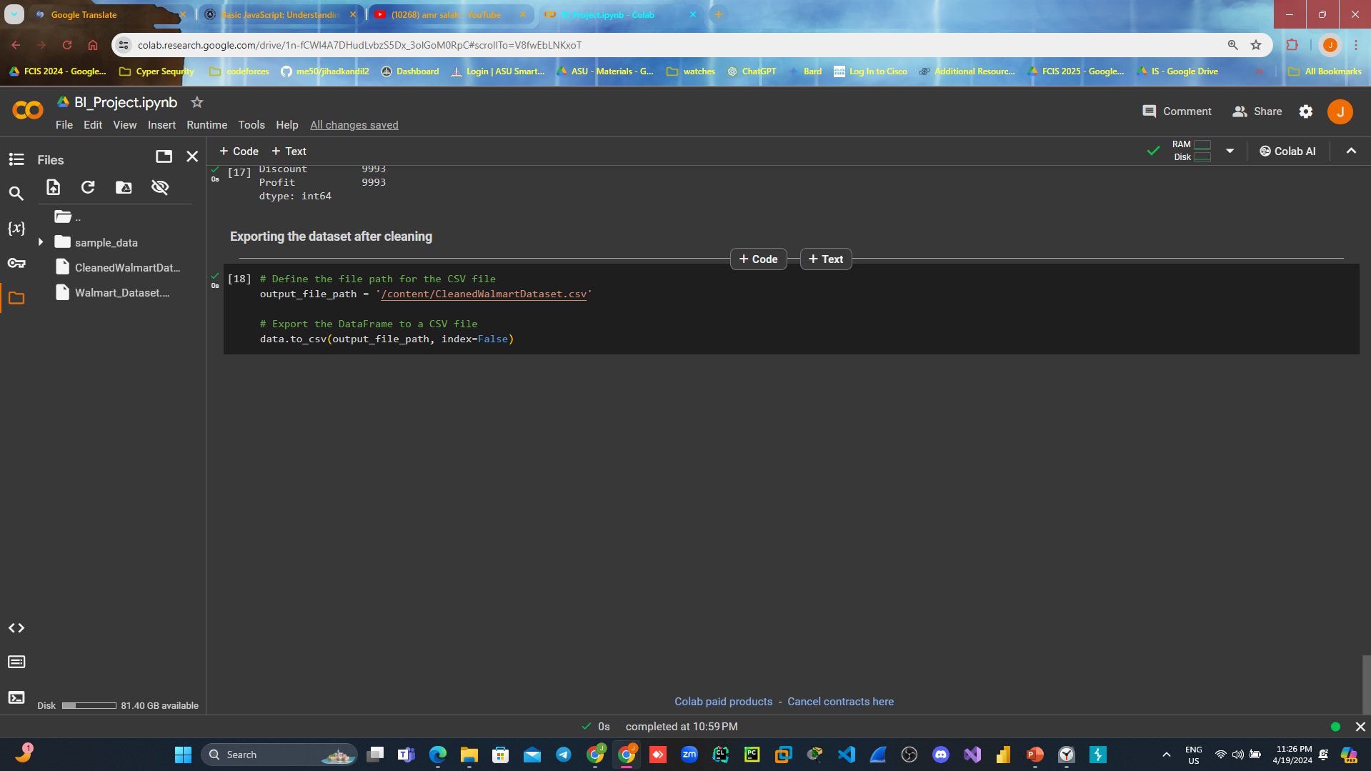
Exporting data set after cleaning it:

Slide 25
Data visualization
Lets visualize data to answer:
o Which product category has the highest sales?
o Which customer segment that contribute to the highest sales?
o Which region, state and city contribute to the highest sales and
profit?
o How the factors have influenced on each other?

Slide 26
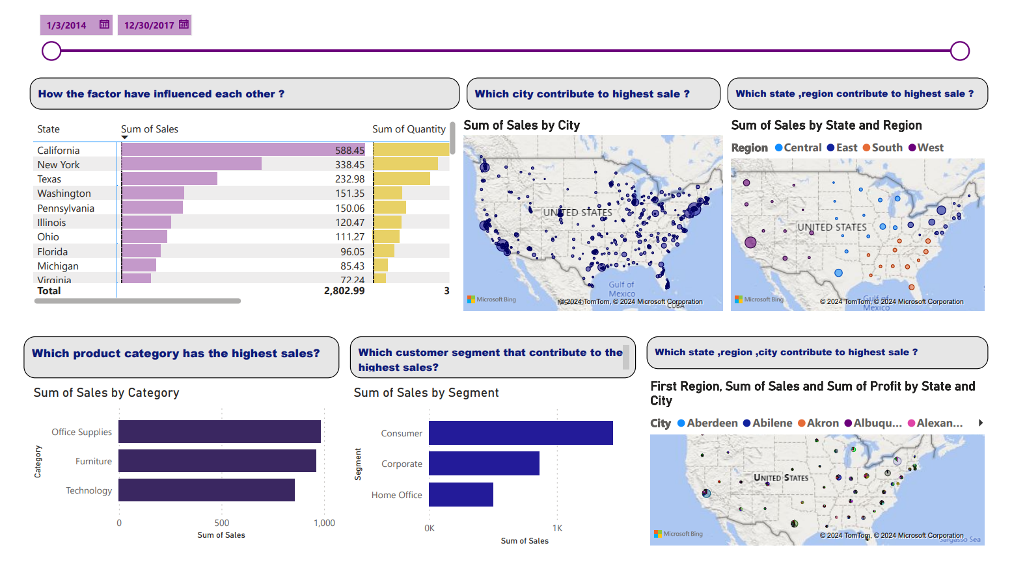
Data visualization continue…

Slide 27
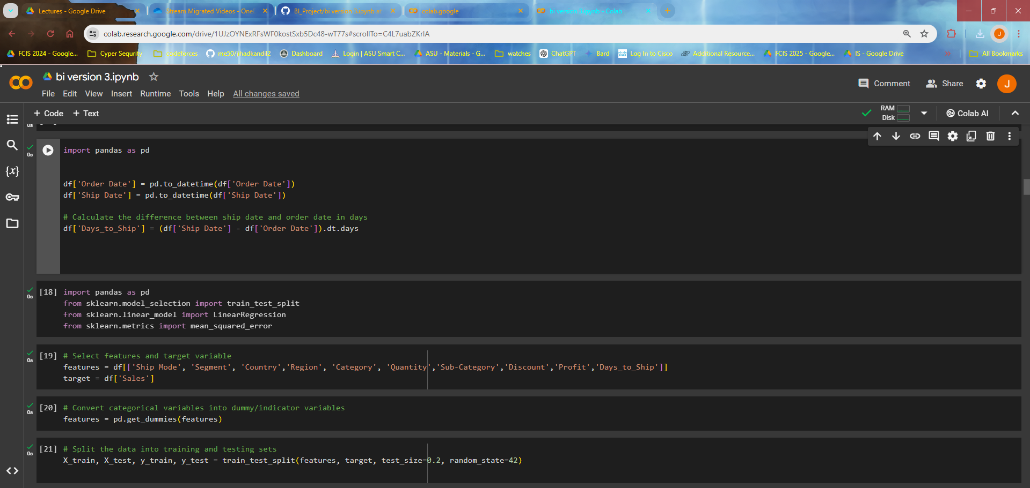
Model

Slide 28
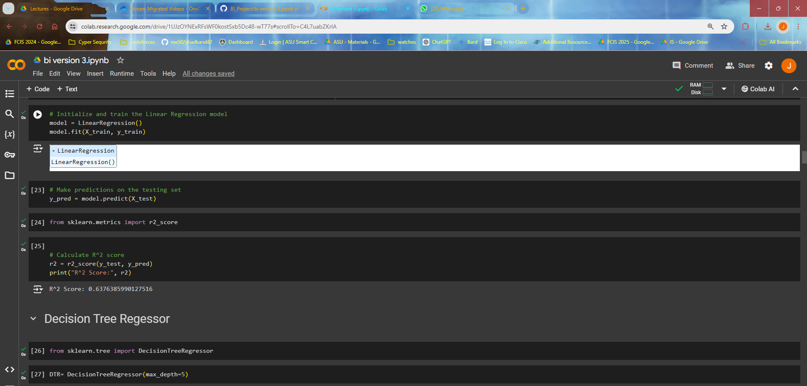
Model cont..

Slide 29
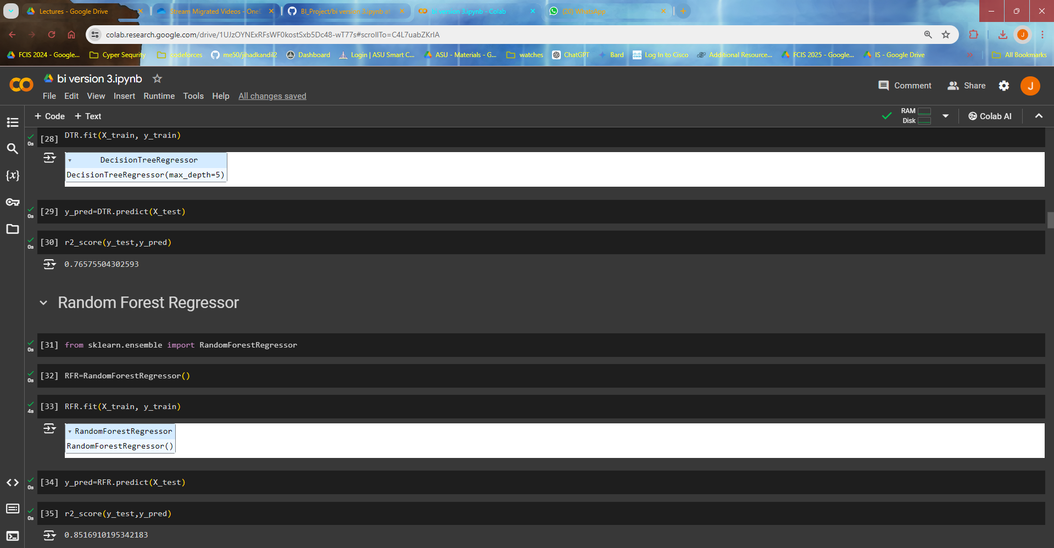
Model cont..

Slide 30
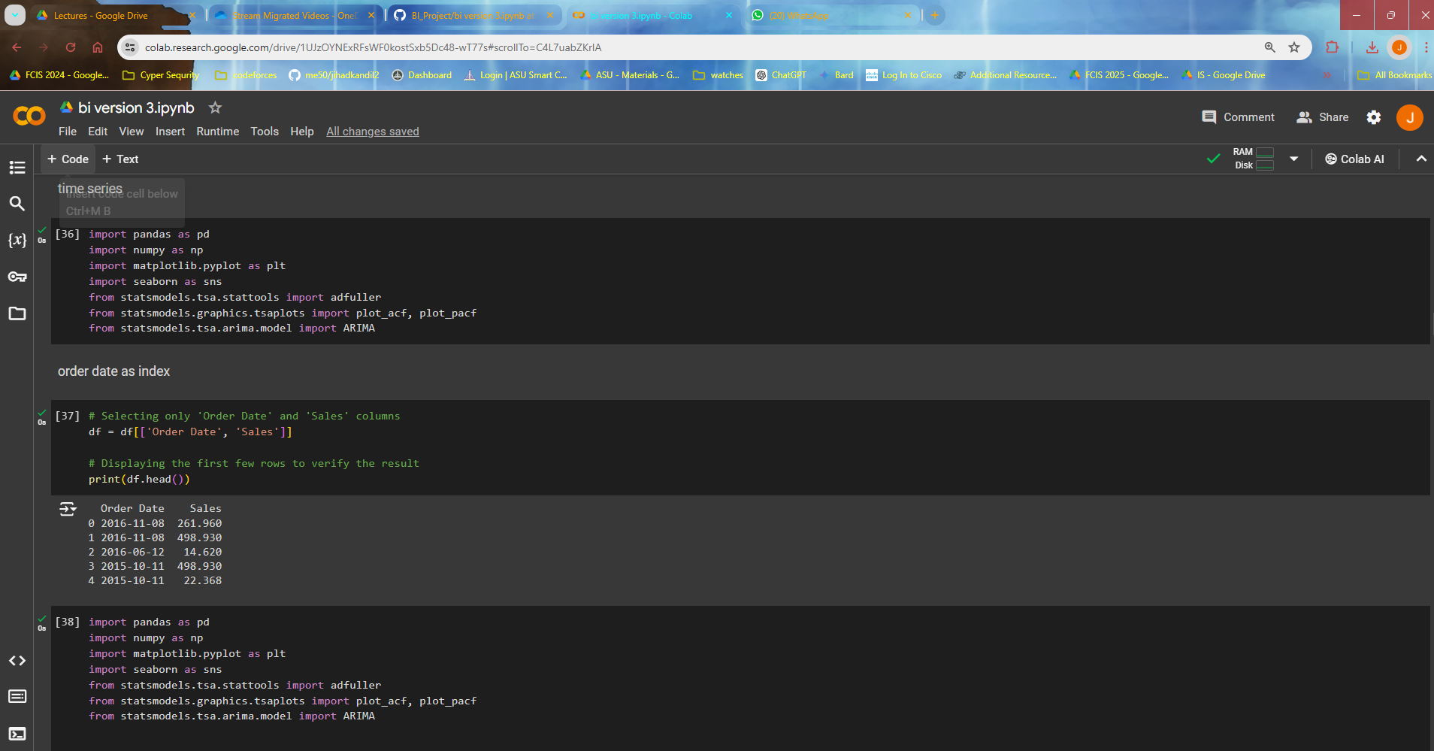
Time series visualization cont..

Slide 31
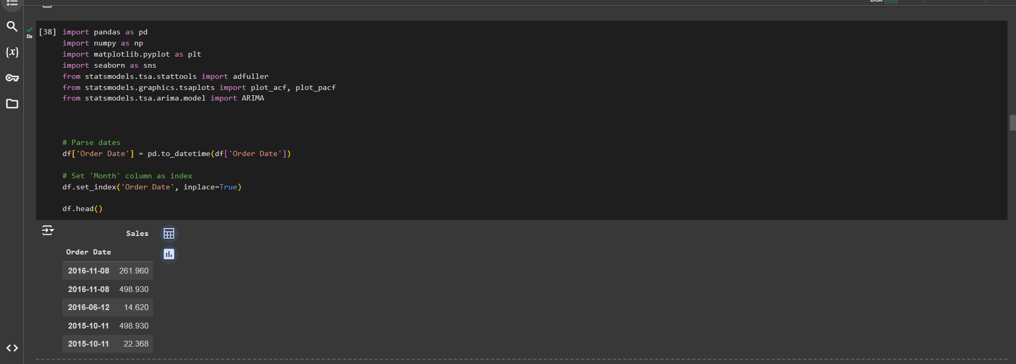
Time series visualization cont..

Slide 32
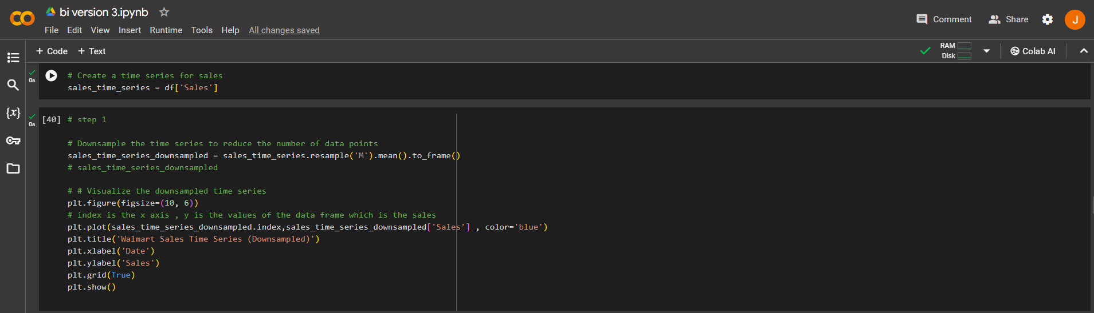
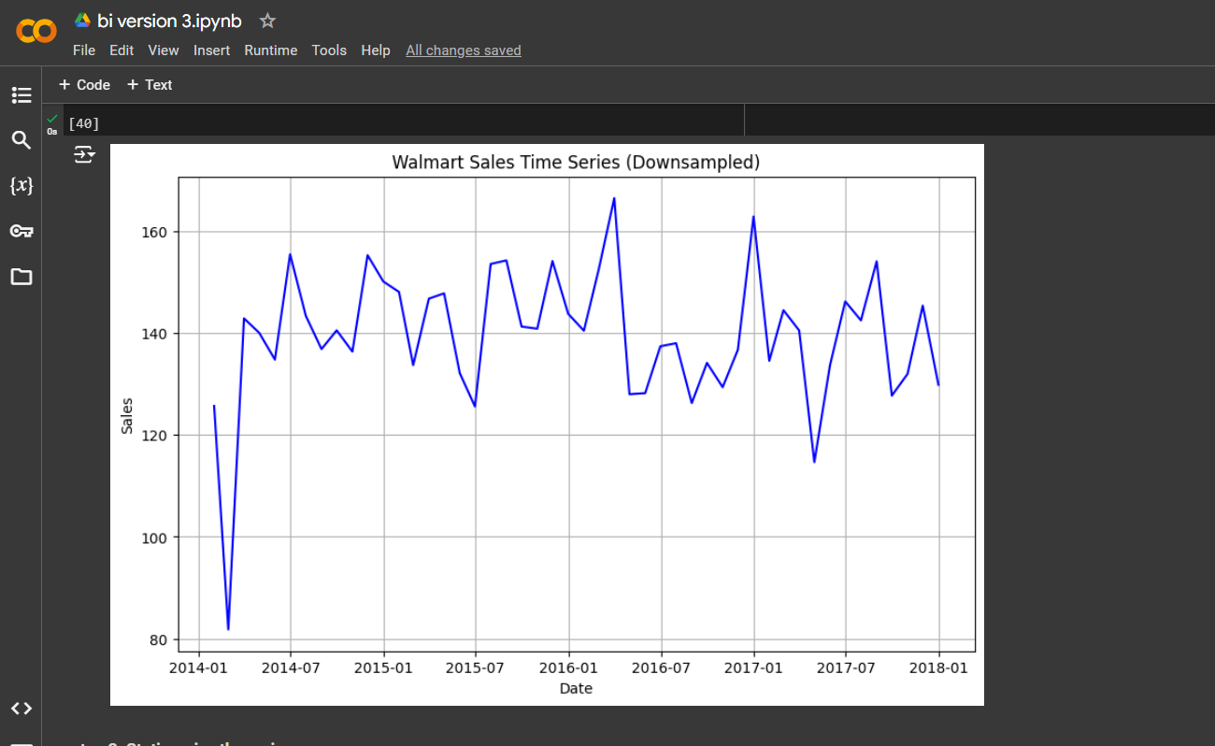
Time series visualization cont..

Slide 33
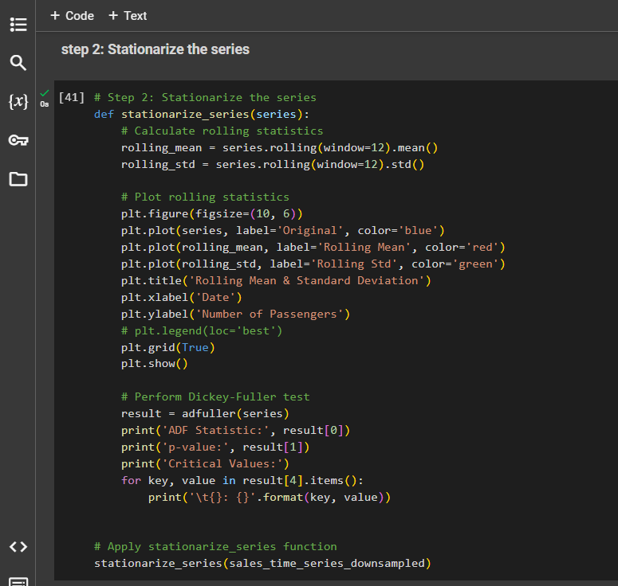
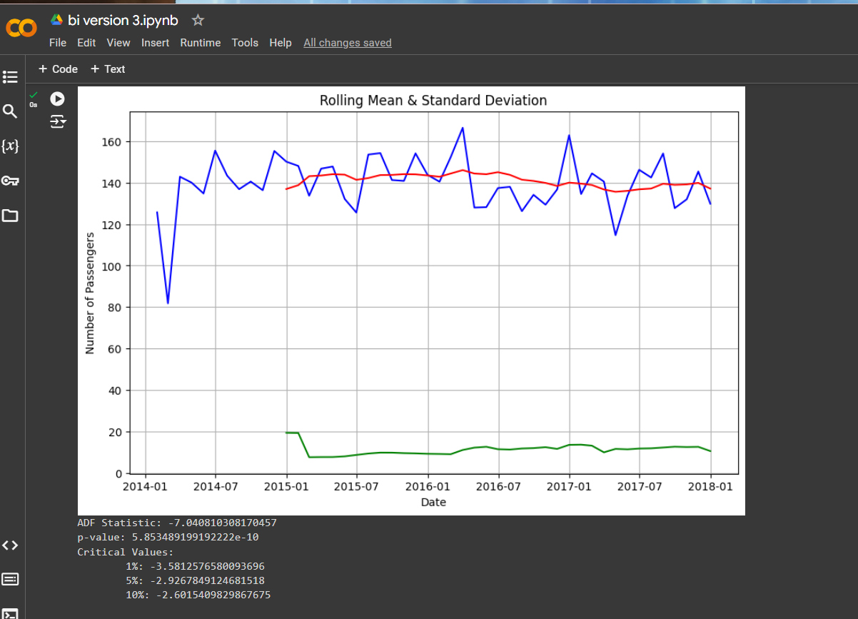
Time series visualization cont..

Slide 34
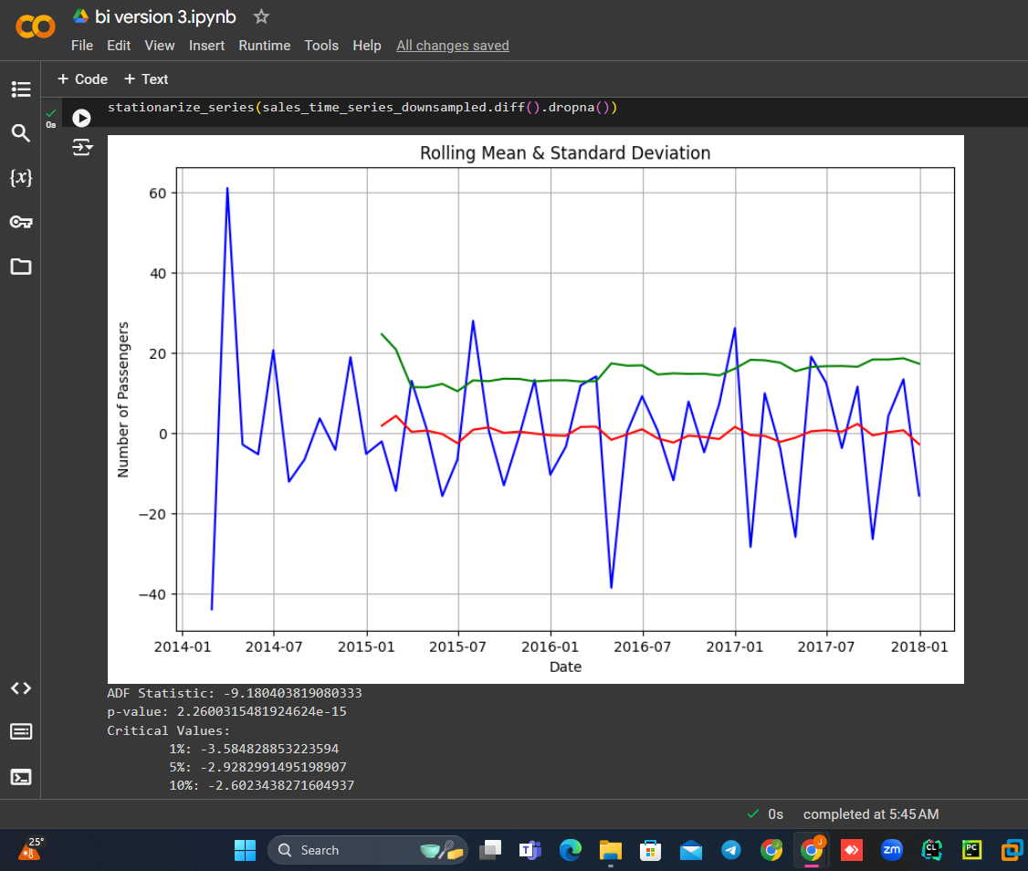
Time series visualization cont..

Slide 35
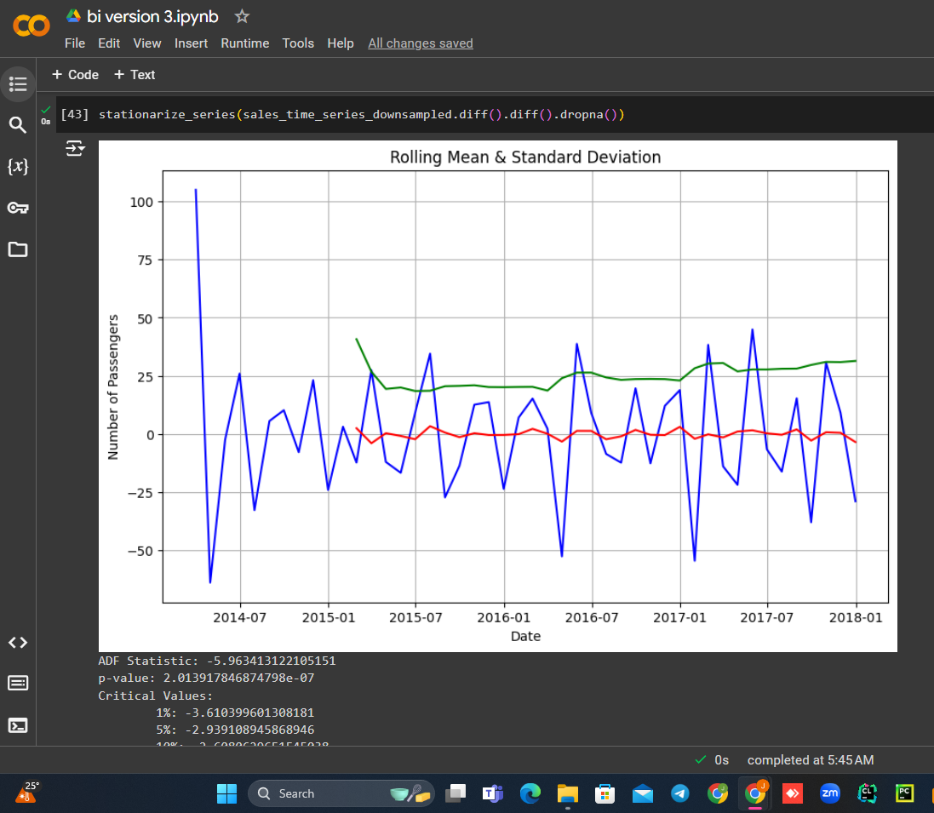
Time series visualization cont..

Slide 36
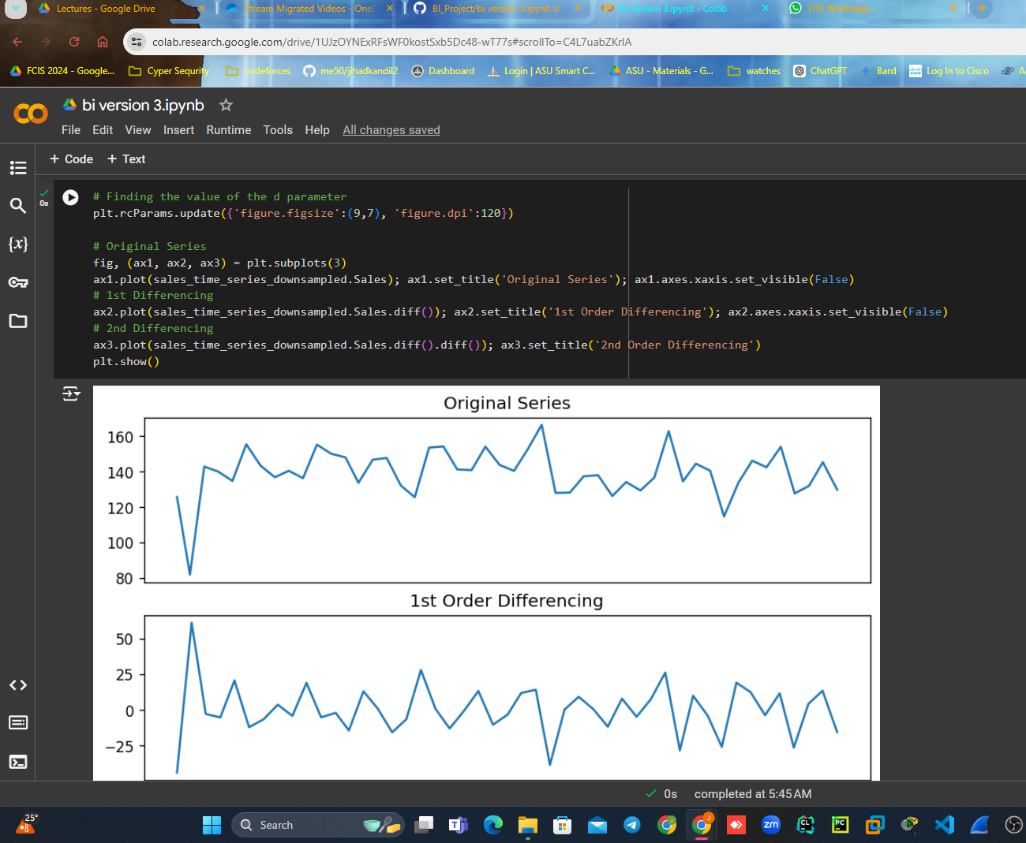
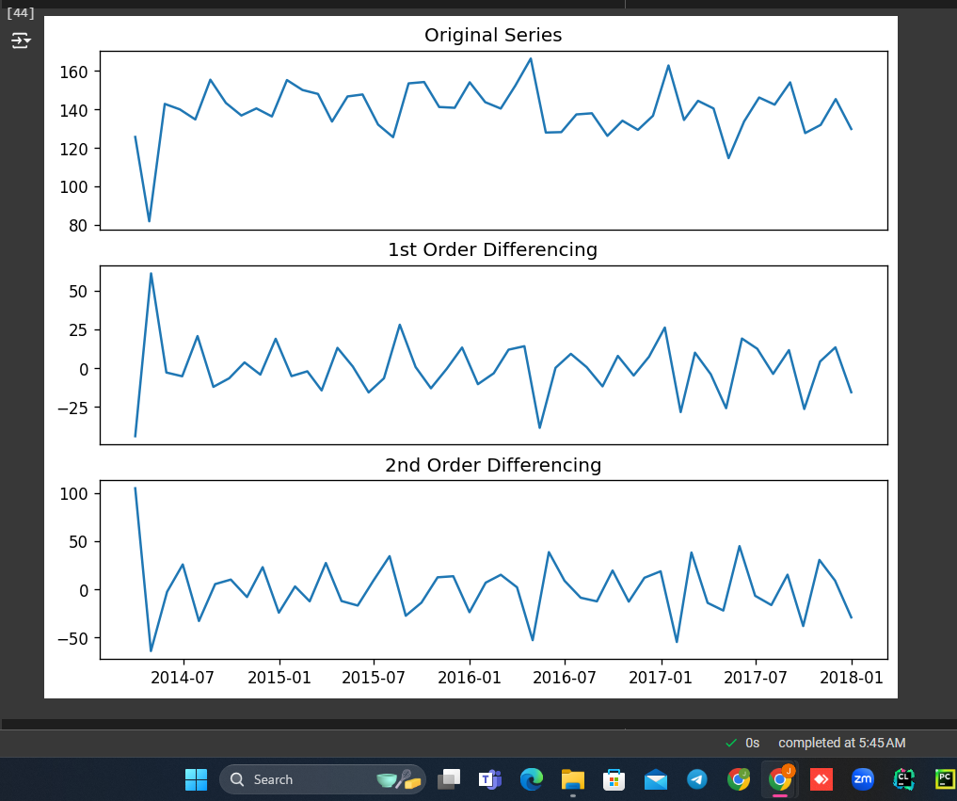
Time series visualization cont..

Slide 37
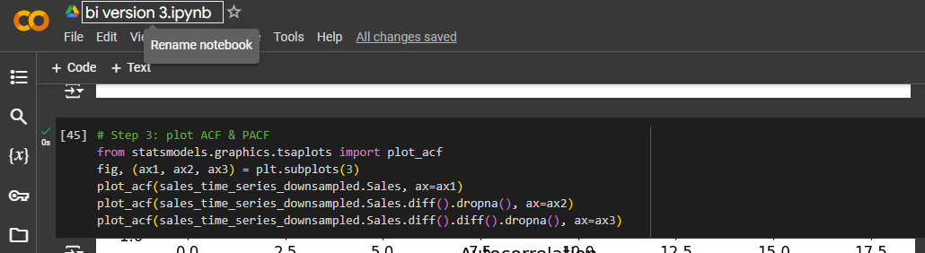
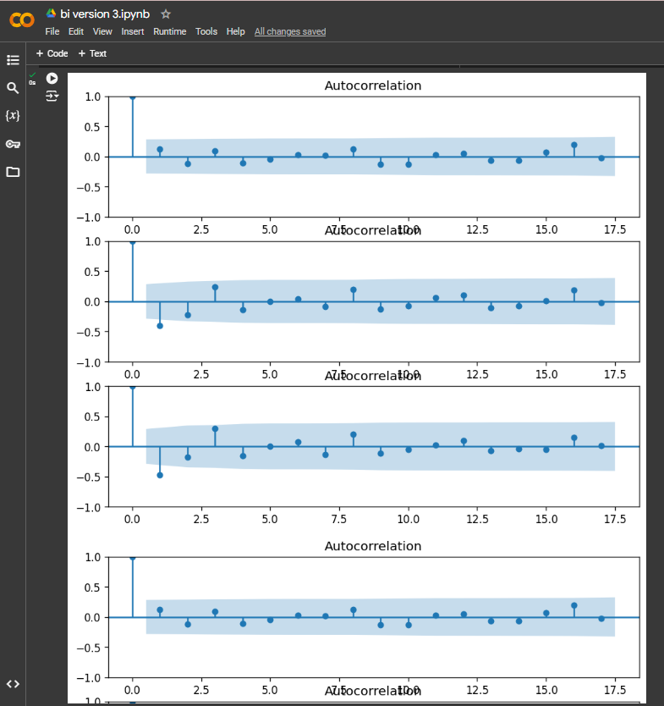
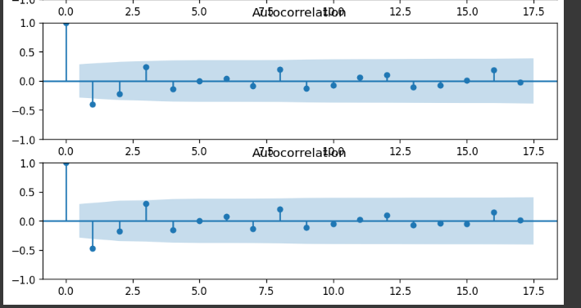
Time series visualization cont..

Slide 38
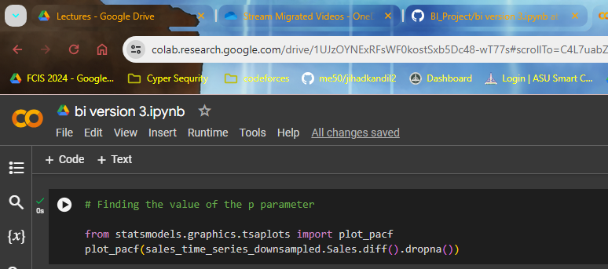
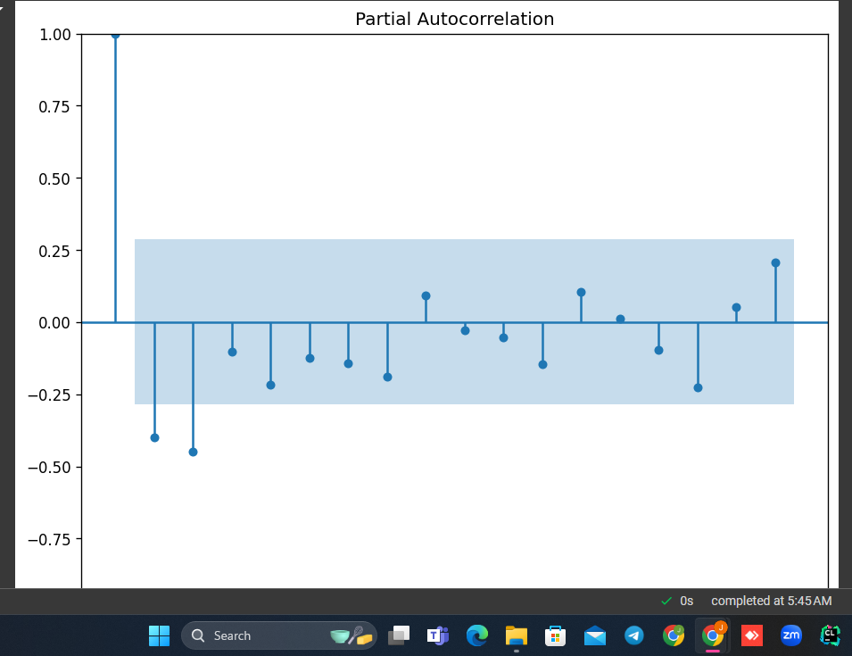
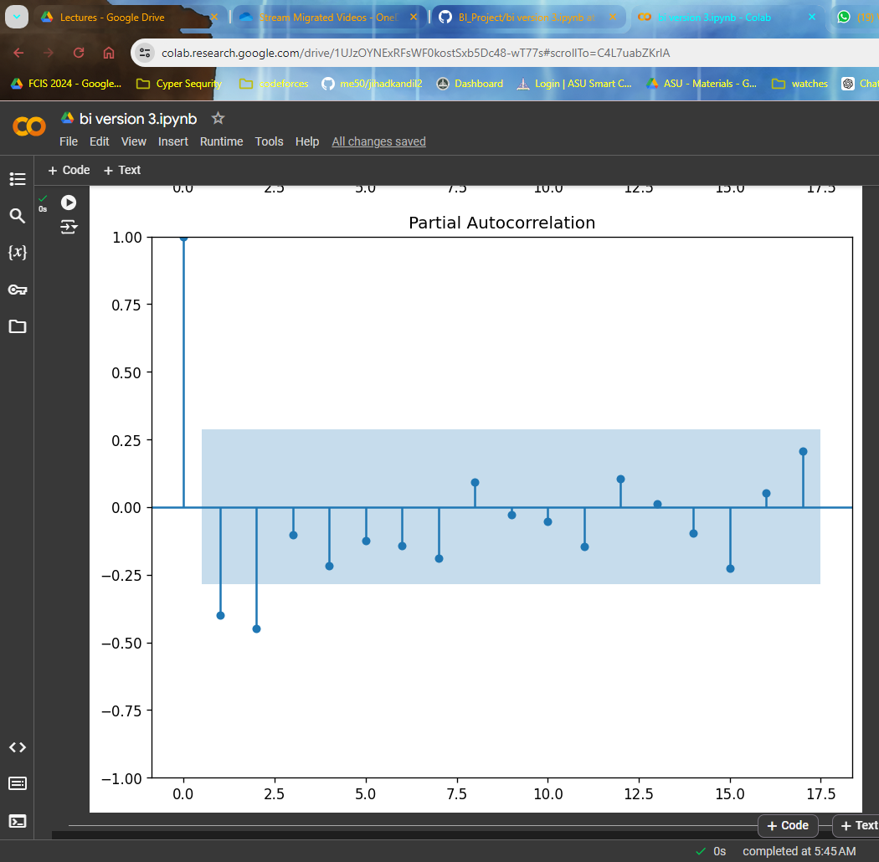
Time series visualization cont..

Slide 39
Time series visualization cont..

Slide 40
conclusion
By synthesizing our findings, we aim to equip Walmart's stakeholders with actionable recommendations to enhance sales performance, optimize resource allocation, and drive sustainable growth.

